Slide 1

Futurense
Democratizing Tech Talent to deliver impact at scale

Slide 2
Health Care Project Dataset:
HealthcareTables

Slide 3
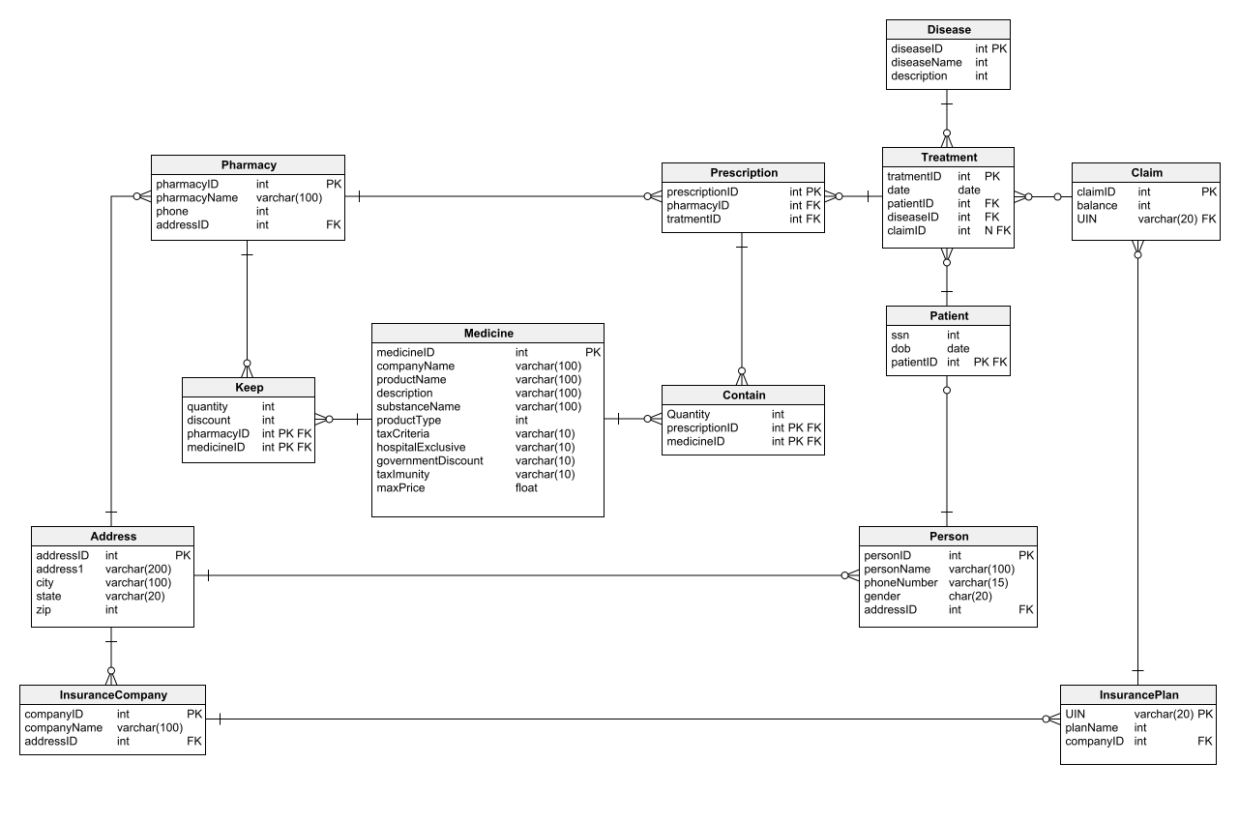

Slide 4
Problem Statement 6: A company needs to set up 3 new pharmacies, they have come up with an idea that the pharmacy can be set up in cities where the pharmacy-to-prescription ratio is the lowest and the number of prescriptions should exceed 100. Assist the company to identify those cities where the pharmacy can be set up. Problem Statement 7 : The State of Alabama (AL) is trying to manage its healthcare resources more efficiently. For each city in their state, they need to identify the disease for which the maximum number of patients have gone for treatment. Assist the state for this purpose. Note: The state of Alabama is represented as AL in Address Table.

Slide 5
Problem Statement 8: The healthcare department needs a report about insurance plans. The report is required to include the insurance plan, which was claimed the most and least for each disease. Assist to create such a report. Problem Statement 9: The Healthcare department wants to know which disease is most likely to infect multiple people in the same household. For each disease find the number of households that has more than one patient with the same disease. Note: 2 people are considered to be in the same household if they have the same address.

Slide 6
Problem Statement 10: An Insurance company wants a state wise report of the treatments to claim ratio between 1st April 2021 and 31st March 2022 (days both included). Assist them to create such a report.

